Slide 1
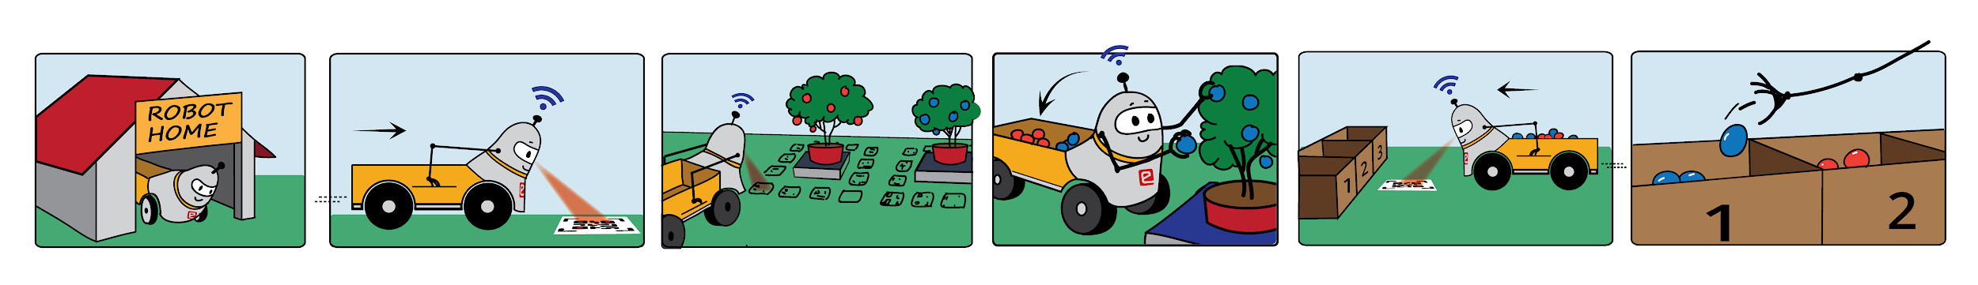
Berryminator (BM)
eYRC 2021-22 Theme
Stats and Learnings
Theme devs -
Amit, Harmanjeet, Shyama, Abhinav, Aditya

Slide 2
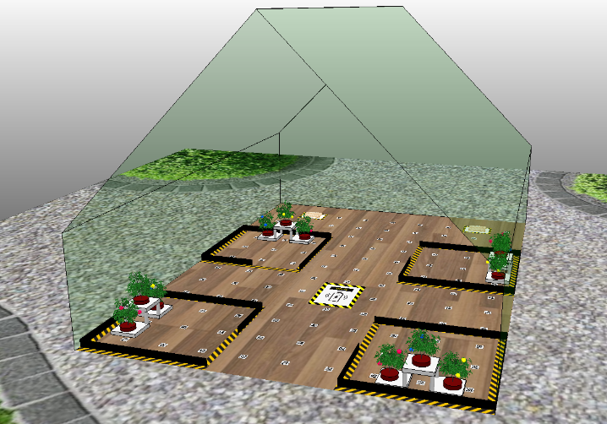
Theme Description
To simulate an automated robot in a simulator that traverses an urban farming scenario to pluck berries and deposit them in the designated sections.
Learnings:
Robotic Simulation
Robotic Arm Design and Manipulation
Plucking and Depositing Mechanism
Image Processing
Navigation and Path Planning
Control Systems
Python and Lua Programming

Slide 3
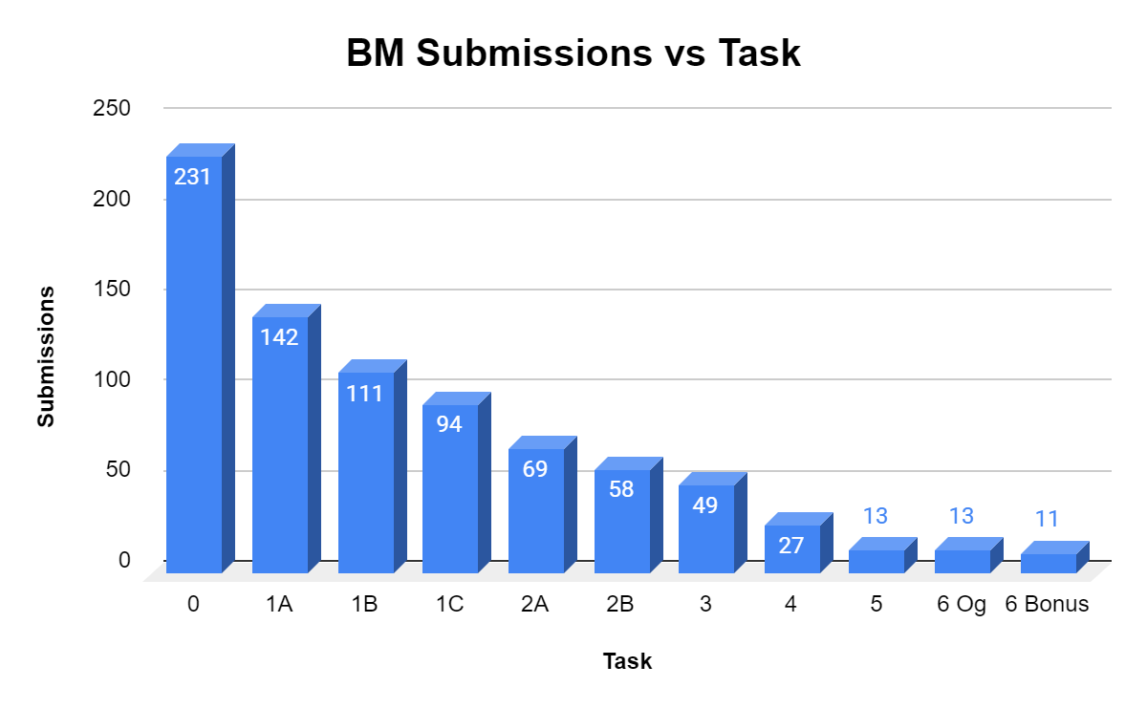
Fig: BM Taskwise Submissions

Slide 4
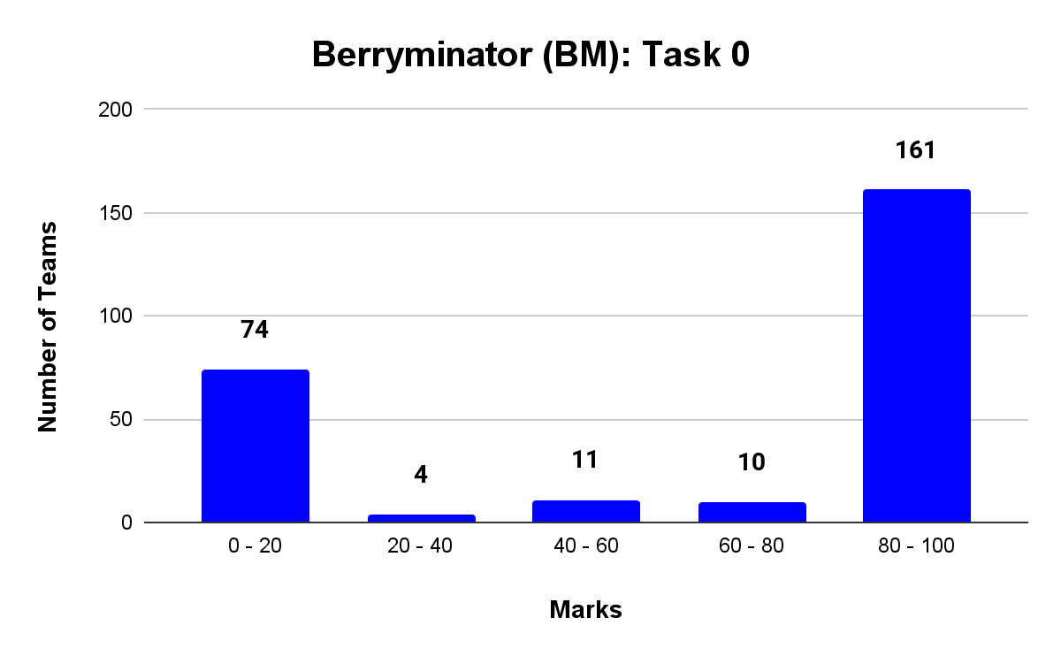
Task 0
Task | Description | Submissions | Total Teams | % Submission | % Submission wrt previous task
0 | Software Installation & Python CodeChef Contest | 231 | 260 | 87 | -
231 interested teams submitted
Maybe video tutorials next time ?
Fig: Task 0 Result

Slide 5
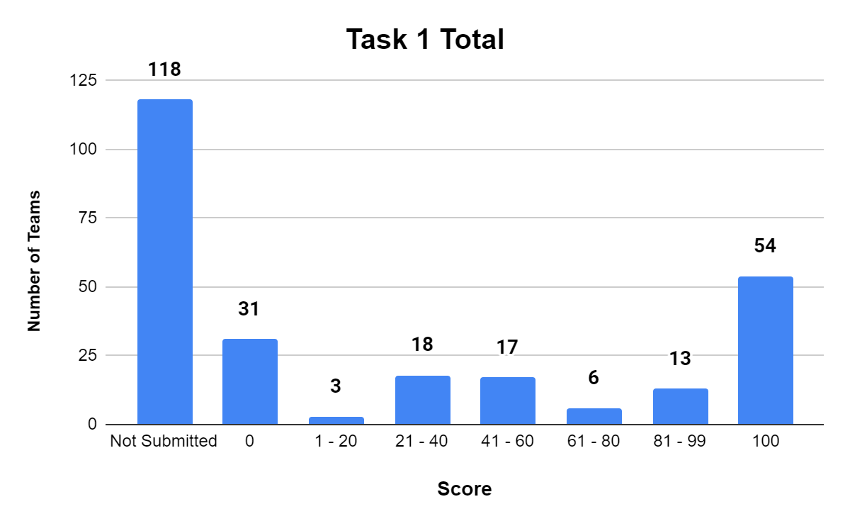
Task 1
Task | Description | Submissions | Total Teams | % Submission | % Submission wrt previous task/ sub task
1A | Explore OpenCV | 142 | 231 | 61.4 | 61.47
1B | Exploring CoppeliaSim (Remote API) | 111 | 231 | 48.05 | 78.16
1C | Exploring CoppeliaSim (Sensors & Joints) | 94 | 231 | 40.6 | 84.68
Duration - 3 weeks
Students overwhelmed by 3 sub tasks
Consider including subtasks gradually
Most of the students in early part of engg.
Plagiarism Check - teams were disqualified too!
Fig: Task 1 Result

Slide 6
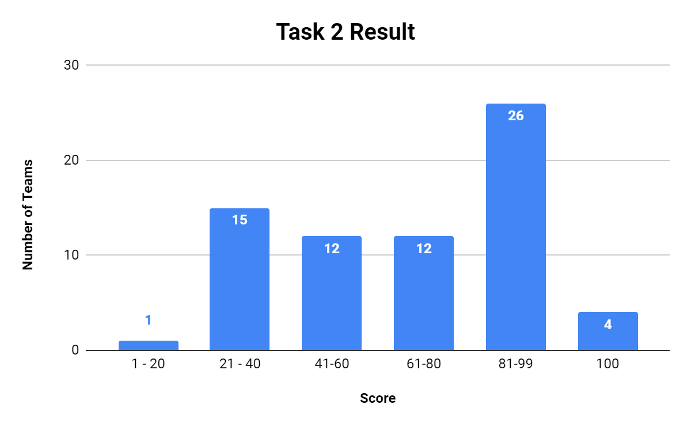
Task 2
Task | Description | Submissions | Total Teams | % Submission | % Submission wrt previous task
2A | Berry Detection in CoppeliaSim | 69 | 231 | 29.87 | 73.40
2B | Robotic Arm Design And Simulation | 58 | 231 | 25.1 | 84.05
Duration - 20 days
Task 2A
Comprehensive documentation given
Task 2B
Design task, CAD, less experience
Two big sub tasks
Clashing with student end-sem exams
Fig: Task 2 Result

Slide 7
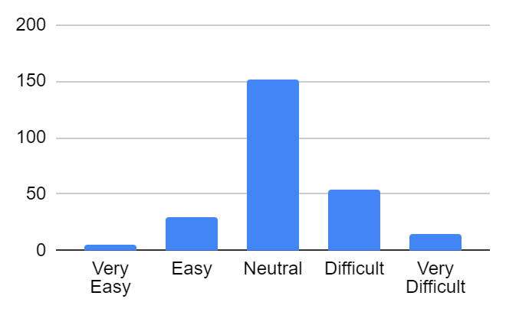
Stage 1 Feedback
Negative comments:
More time could be given for tasks completion considering the academic works at college
More resources should be given during the competition
The robotic arm task can be kept in the later tasks
What can be done?
Less number of subtasks
Design task in stage 2
Hard deadline concept ?
Basically shift this graph to the left
Fig: Stage 1 Task Easiness

Slide 8
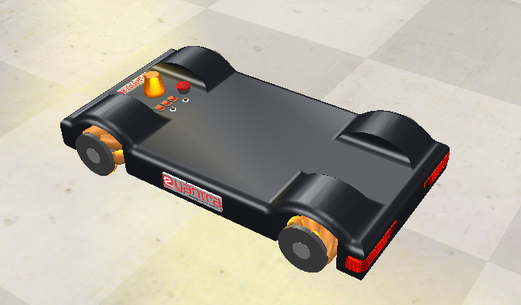
Task 3
Task | Description | Submissions | Total Teams | % Submission | % Submission wrt previous task
3 | Navigation | 49 | 231 | 21.21 | 84.48
Duration - 20 days
Teams were given two documents
Task 3 instructions
Task 3 pointers doc for weaker teams
Fig: Mobile vehicle given in task 3

Slide 9
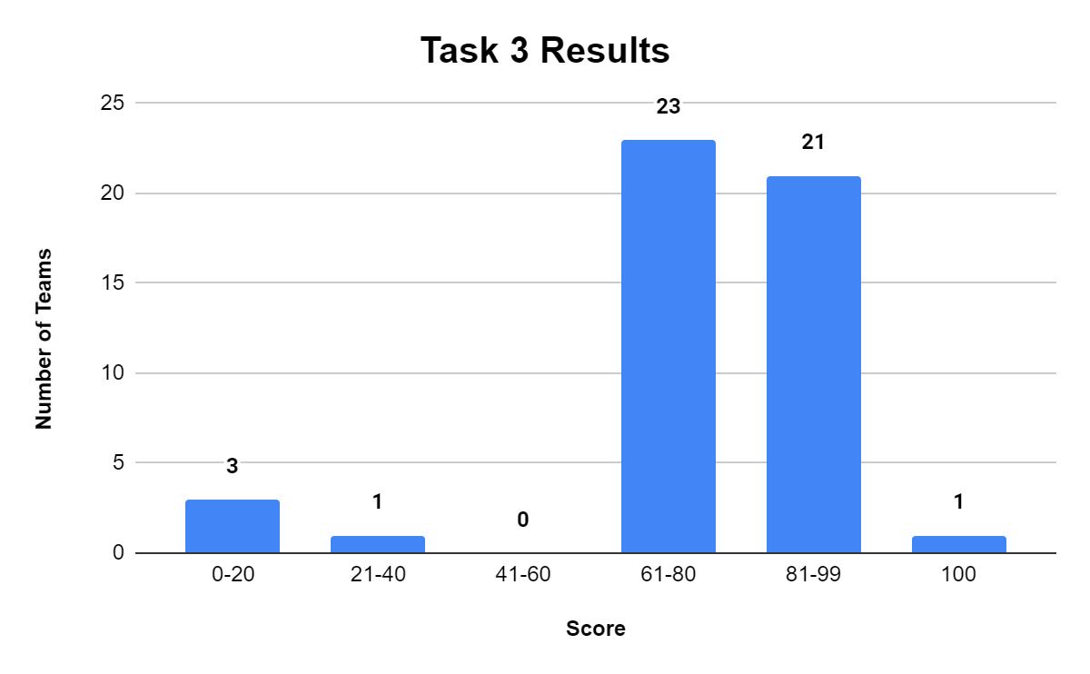
Task 3
Task | Description | Submissions | Total Teams | % Submission | % Submission wrt previous task
3 | Navigation | 49 | 231 | 21.21 | 84.48
Relatively easier task
If repeated, could be kept in Stage 1
Fig: Task 3 Result

Slide 10
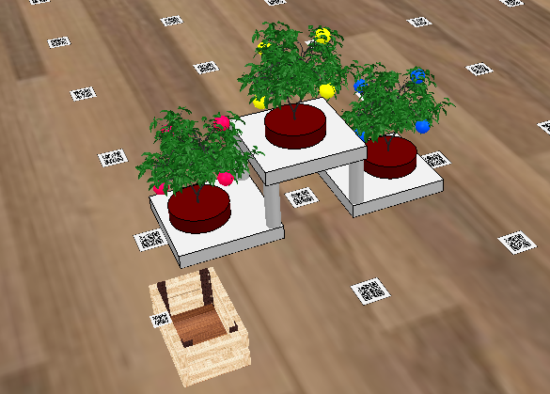
Task 4
Task | Description | Submissions | Total Teams | % Submission | % Submission wrt previous task
4 | Pluck & Deposit | 27 | 231 | 11.68 | 55.10
Duration - 20 days
Teams were given two documents
Task - 4 Instructions
Task 4 Pointers
Concepts involved:
2A: Berry Detection
2B: Arm
3: Navigation
4: IK, Arm manipulation, Lua
Fig: Task 4 scene

Slide 11
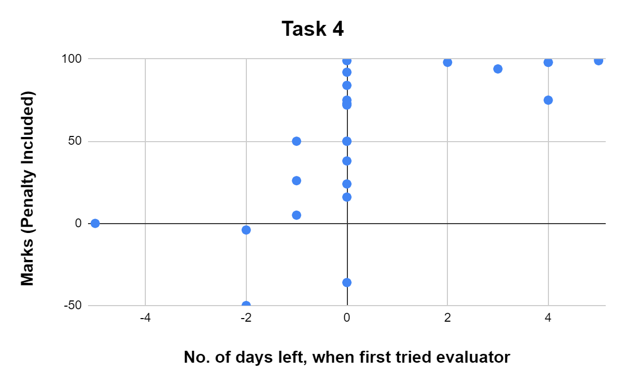
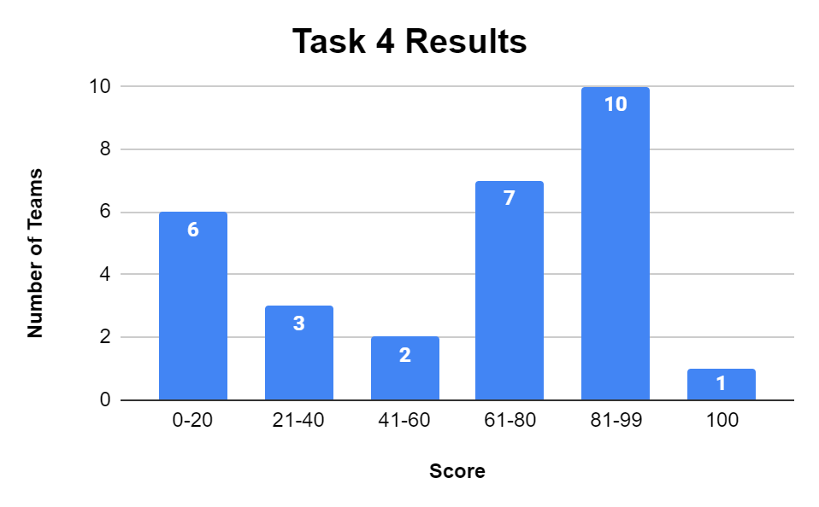
Task 4
Fig: Task 4 RTS Insight
Fig: Task 4 Results
Incentive(Bonus) if they submit early?

Slide 12
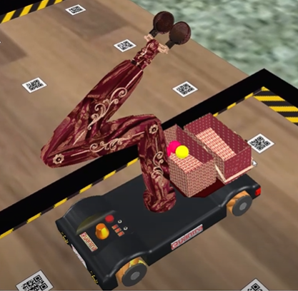
Task 5
Task | Description | Submissions | Total Teams | % Submission | % Submission wrt previous task
5 | Mini Theme Implementation | 13 | 231 | 4.98 | 48.14
Duration - 19 days
Again new concepts involved
Tasks 1 to 4
Random room entries
Basket
Leaderboard
Rulebook scoring
Fig: Example basket
Fig: Task 5 scene - Final Theme Arena

Slide 13
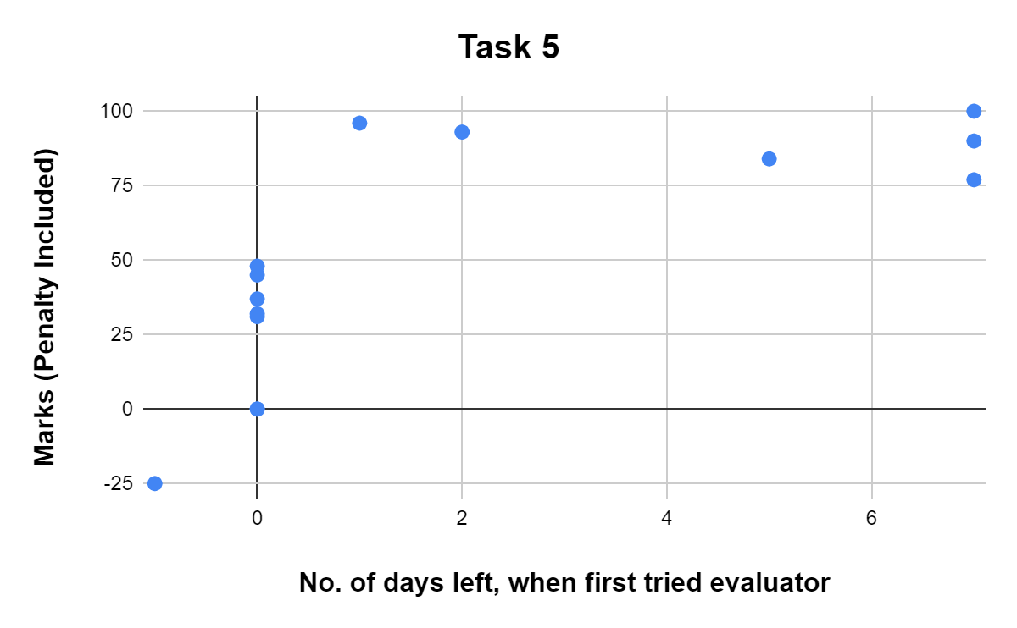
Task 5
Fig: Task 5 RTS Insight

Slide 14
Task 6
Task | Description | Submissions | Total Teams | % Submission | % Submission wrt previous task
6 | Full Theme Implementation : Original | 13 | 231 | 4.98 | 100
 | Bonus | 11 | 231 | 4.76 | 84.61
48 hrs og + bonus task
Teams didn’t face any issue
No changes compared to task 5
Same scoring, arena
Only required berries are changed
Pre Finale - 3 hrs task
Fig: Task 6 scene - Final Theme Arena

Slide 15
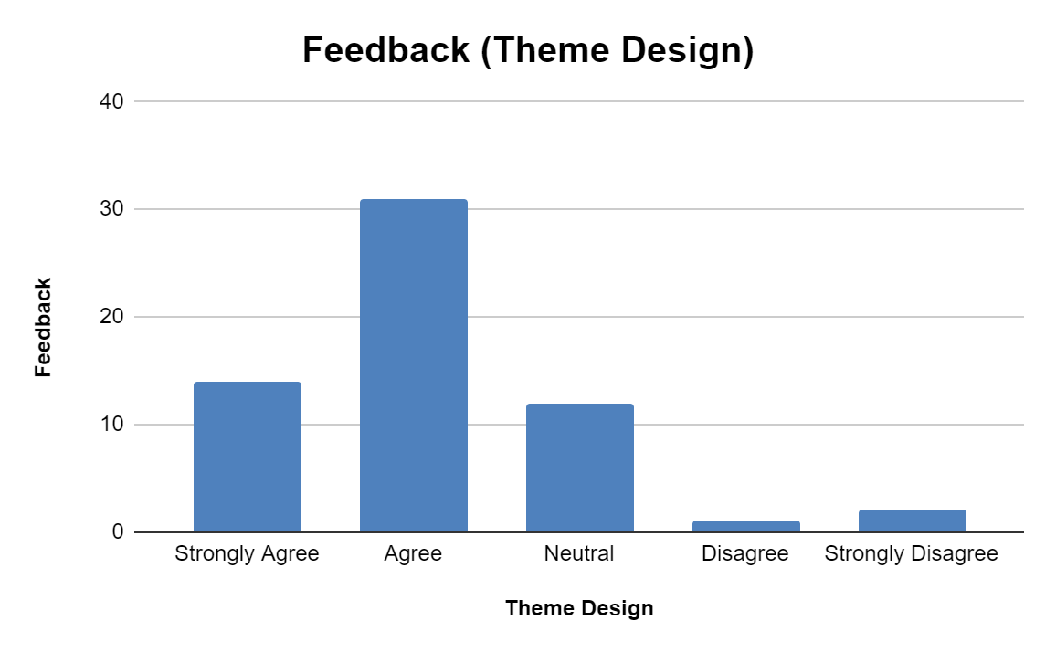
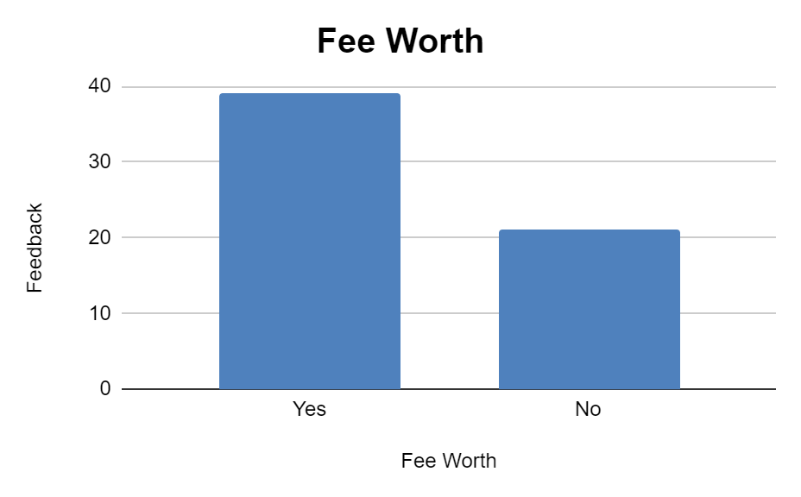
Stage 2 Feedback

Slide 16
Stage 2 Feedback
Comments regarding leaderboard
It was very much helping in deciding where we are with respect to other teams and our team worked hard to increase our rank
it tells us our relative strength with respect to others and motivates us to improve our algorithm
Got motivation
It didn't help as much as it would have if it had shown us the gap between our score and the score of the team right above us … all we knew, the team above could have been just 5 points ahead or a hundred
… This is not called a leaderboard lol. Please understand the meaning of an actual leaderboard the next time. It should have the rankings of all the teams along with their scores …

Slide 17
Stage 2 Feedback
Comments in general
we feel happy to be a part of this competition. thank you eyantra for giving this opportunity to develop ourselves
i have developed soo much in many aspects . I am grateful for joining eyrc
I have not tried it out, but the new version(4.3.0) of CoppeliaSim is enticing.

Slide 18
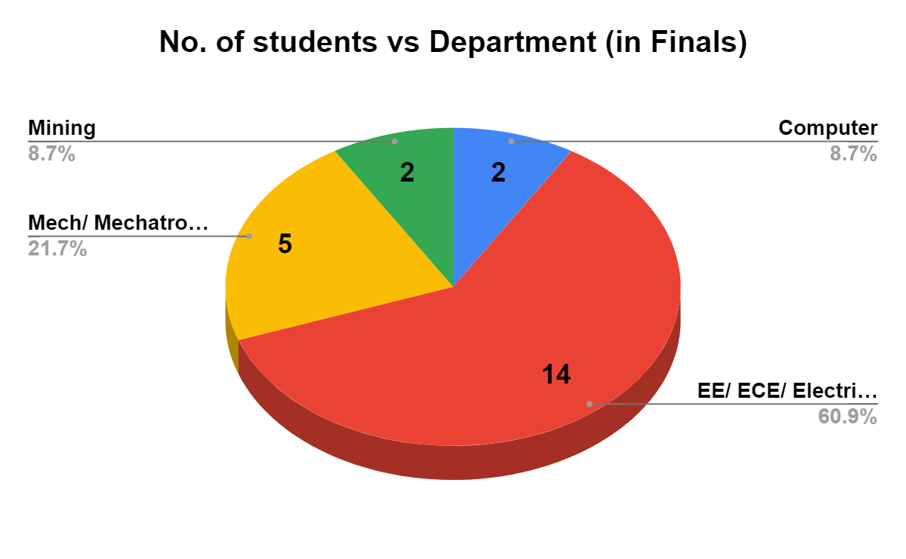
Finale Insights
6 Teams : 23 participants

Slide 19
Finale Insights
Team Id | eYRC Experience | No. of times they ran our evaluator (in original config.)
1067 | One participant in NB of 2020 | 3
1211 | None | 7
1072 | None | 2
1809 | None | 8
1707 | All four participants in SB and VD of 2020 | 1
2509 | None | 10
Should remember: We took mostly 1st and 2nd year students in BM
All 6 teams are very close

Slide 20
Task | Description | Submissions | Total Teams | % Submission | % Submission wrt previous task
0 | Software Installation & Python CodeChef Contest | 231 | 260 | 87 | -
1A | Explore OpenCV | 142 | 231 | 61.4 | 61.47
1B | Exploring CoppeliaSim (Remote API) | 111 | 231 | 48.05 | 78.16
1C | Exploring CoppeliaSim (Sensors & Joints) | 94 | 231 | 40.6 | 84.68
2A | Berry Detection in CoppeliaSim | 69 | 231 | 29.87 | 73.40
2B | Robotic Arm Design And Simulation | 58 | 231 | 25.1 | 84.05
3 | Navigation | 49 | 231 | 21.21 | 84.48
4 | Pluck & Deposit | 27 | 231 | 11.68 | 55.10
5 | Mini Theme Implementation | 13 | 231 | 4.98 | 48.14
6 | Full Theme Implementation : Original | 13 | 231 | 4.98 | 100
 | Bonus | 11 | 231 | 4.76 | 84.61
Table: Taskwise Submissions Summary

Slide 21
Auto evaluation
Executable given for each task
Client side evaluation
Beneficial for students and us
Development takes time (as developed from scratch)
Needs thorough testing before release
Start early
More concerns
Students wrote code in Lua, we couldn’t check
CoppeliaSim 4.3

Slide 22
BM Theme Takeaways
Full leaderboard or some activity engagement system (Stage 2)
Explore CoppeliaSim 4.3
Prepare theme early, have more iterations
Develop evaluator early too
In iterations
Reduce number of subtasks in stage 1
Or make task 1 as easy as possible
Try to keep design task in stage 2
Don’t add too many concepts in one task; gradual integration of learning developed in previous tasks.
Later, take advice from faculty
While theme is on
Focus on participants engagement > Theme development

Slide 23
Thank You !

